Slide 1
ER diagrams
Avinash Pathak

Slide 2
Objectives
To update on the Data Modelling mechanism
To use the ER tools for Database design
To understand the relationship patterns
To present a Data View of the System

Slide 3
ER Diagrams
One of the most difficult phases of database design is the fact that designers, programmers, and end-users tend to view data and its use in various forms.
Unfortunately, unless all the database learners gain a common understanding that reflects how the enterprise operates but the design you may produce will fail to meet the users' requirements.

Slide 4
ER Diagrams
To ensure that you get a precise understanding of the nature of the data and how the enterprise uses it, you need to have a universal model for interaction that is non-technical and free of ambiguities and easily readable to both technical as well as non-technical members.
So the ER (Entity Relationship) Model was designed and developed and are represented by an ER diagram.

Slide 5
ER Diagrams
ER-Diagram is a pictorial representation of data that describes how data is communicated and related to each other.
Any object, such as entities, attributes of an entity, sets of relationship and other attributes of relationship can be characterized with the help of the ER diagram.
Entities: They are represented using the rectangle shape box.
These rectangles are named with the entity set they represent.

Slide 6
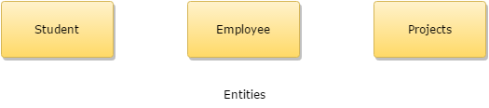

Slide 7
ER modeling
ER modeling is a top-down structure to database design that begins with identifying the important data called entities and relationships in combination with the data that must be characterized in the model.
Then database model designers can add more details such as the information they want to hold about the entities and relationships which are the attributes and any constraints on the entities, relationships, and attributes.
ER modeling is an important technique for any database designer to master and forms the basis of the methodology.

Slide 8
ER modeling
Entity type:
It is a group of objects with the same properties that are identified by the enterprise as having an independent existence.
The basic concept of the ER model is the entity type that is used to represent a group of 'objects' in the 'real world' with the same properties.
An entity type has an independent existence within a database.
Entity occurrence:
A uniquely identifiable object of an entity type.

Slide 9
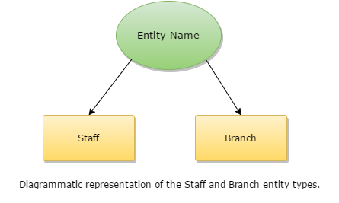

Slide 10
Relationship
A relationship type is a set of associations between one or more participating entity types.
Each relationship type is given a name that describes its function.

Slide 11
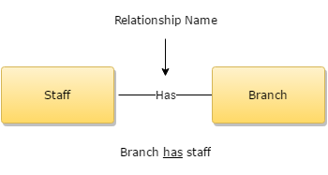

Slide 12
Relationship
The entities occupied in a particular relationship type are referred to as participants in that relationship.
The number of participants involved in a relationship type is termed as the degree of that relationship.
. A relationship of degree two is called binary degree (relationship).

Slide 13
Attributes
Attributes are the properties of entities that are represented using ellipse shaped figures.
Every elliptical figure represents one attribute and is directly connected to its entity (which is represented as a rectangle).

Slide 14
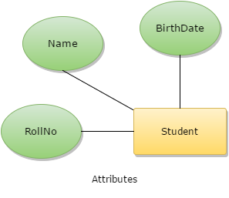

Slide 15

Attributes
It is to be noted that multi-valued attributes are represented using double ellipse like this:

Slide 16
Attributes
A diamond-shaped box represents relationships.
All the entities (rectangle shaped) participating in a relationship gets connected using a line.

Slide 17


Slide 18
Relationship Mappings
One-to-one: When only a single instance of an entity is associated with the relationship, it is termed as '1:1'.
One-to-many: When more than one instance of an entity is related and linked with a relationship, it is termed as '1:N'.
Many-to-one: When more than one instance of an entity is linked with the relationship, it is termed as 'N:1'.
Many-to-many: When more than one instance of an entity on the left and more than one instance of an entity on the right can be linked with the relationship, then it is termed as N:N relationship.

Slide 19
Generalization
In generalization, some entities are accommodated together into one generalized entity or category based on their similar characteristics.
In the below-mentioned figure, whale, shark, and dolphin are generalized as fish, i.e., they have been categorized as the fish.

Slide 20
Generalization
Super-class:
An entity type that includes one or more dissimilar sub-groupings of its occurrences that is required to be represented in a data model.
Sub-class:
A distinct sub-grouping of occurrences of an entity type that require being represented in a data model.

Slide 21
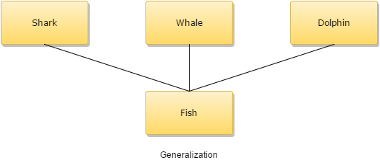

Slide 22
Aggregation
A relationship represents a connection between two entity types that are conceptually at the same level.
Sometimes you may want to model a 'has-a,' 'is-a' or 'is-part-of' relationship, in which one entity represents a larger entity (the 'whole') that will consist of smaller entities (the 'parts').
This special kind of relationship is termed as an aggregation.

Slide 23
Aggregation
Aggregation does not change the meaning of navigation and routing across the relationship between the whole and its parts.
An example of aggregation is the 'Teacher' entity following the 'syllabus' entity act as a single entity in the relationship.
In simple words, aggregation is a process where the relation between two entities is treated as a single entity.

Slide 24
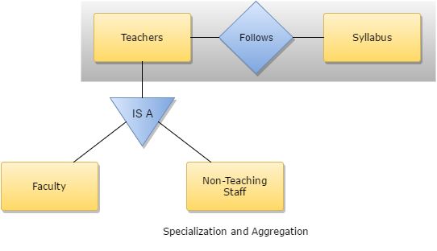

Slide 25
Thank you

